Slide 1
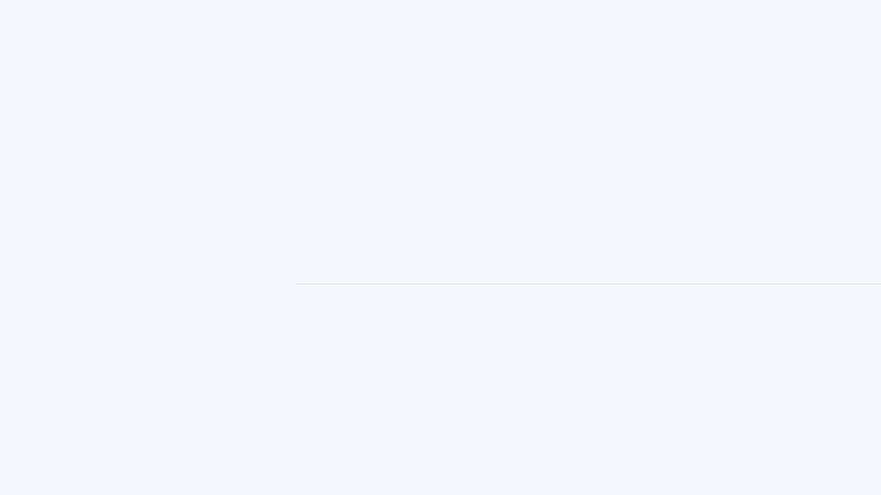

Hospital Management System
Implementing the Observer Design Pattern
HMS
COURSE DETAILS
TEAM MEMBERS
Pattern Programming
Qasem Al-Humaidi
Real-time UI Sync
Khalil Al-Masri
Mahmoud Nimr
Mohammed Al-Homsi

Slide 2





Project Overview & Objectives
Primary Objective
To build a robust Hospital Management System (HMS) that handles patient records, staff management, and real-time data visualization using advanced design patterns.
Patient Registration & Tracking
Staff & Department Management
Core Architecture: Built using Java Swing with a focus on decoupling data from the user interface.
Real-time Dashboard
System Event Logging

Slide 3



The Challenge: UI Synchronization
How do we keep multiple UI components (tables, dashboards, logs) updated instantly when hospital data changes without creating a mess?
Tight Coupling
Maintenance Nightmare
Inconsistency
The data layer must explicitly know about every UI component, making it rigid and hard to modify.
Adding a new view requires modifying the core data logic, violating the Open/Closed Principle.
Manual updates are prone to errors, where some views might fail to refresh, leading to stale data.

Slide 4

The Solution: Observer Design Pattern
Loose Coupling
What is it?
The Subject doesn't need to know the details of its Observers, only that they implement a specific interface.
A behavioral design pattern that defines a one-to-many dependency between objects so that when one object changes state, all its dependents are notified and updated automatically.
Dynamic Relationships
Observers can be added or removed at runtime without modifying the Subject's code.
"Don't call us, we'll call you."
Broadcast Communication
Efficiently updates multiple UI components simultaneously from a single data change event.

Slide 5
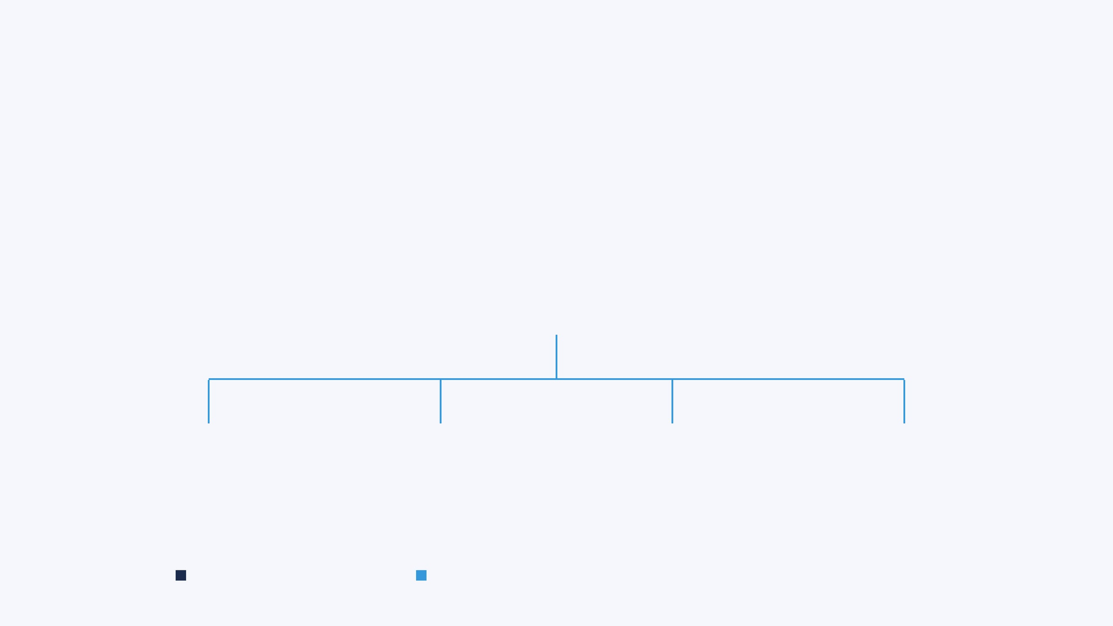




Observer Pattern Architecture
CONCRETE SUBJECT
HospitalData
Maintains State & Notifies
Dashboard Observer
Patient Table Observer
Staff Table Observer
Event Log Observer
Subject: The source of truth
Notification: Automatic broadcast
Observers: Independent UI views

Slide 6



Core Interfaces: Subject & Observer
HospitalObserver.java
HospitalSubject.java
// The Observer Interface public interface HospitalObserver { void update(HospitalEvent event); void subscribe(); void unsubscribe(); }
// The Subject Interface public interface HospitalSubject { void registerObserver(HospitalObserver o); void removeObserver(HospitalObserver o); void notifyObservers(HospitalEvent e); }

Slide 7


Event-Driven Communication Model
// Centralized Event Types
The role of the Enum in the Observer Pattern:
public enum
HospitalEvent
{
Category
Impacted Observers
PATIENT_ADDED,
PATIENT_UPDATED,
PatientTable, Dashboard, EventLog
PATIENT_DELETED,
PATIENT
EMPLOYEE_ADDED,
Added, Updated, Deleted
EMPLOYEE_DELETED,
StaffTable, DeptTree, Dashboard
DATA_LOADED;
EMPLOYEE
Added, Deleted
// Human-readable labels
All Registered Observers
private final
String label;
SYSTEM
...
Data Loaded
}
The Enum allows observers to filter
notifications and only perform
expensive UI refreshes when relevant data changes.

Slide 8

Concrete Subject: HospitalData
public class
HospitalData
implements
HospitalSubject
{
State Management: HospitalData acts as the single source of truth for all hospital records.
// List of registered observers
private final
List
<
HospitalObserver
> observers =
new
ArrayList
<>();
Automatic Notification: Every mutation method (add, delete, update) triggers a broadcast to all observers.
public boolean
addPatient
(
Patient
p) {
// ... logic to add patient ...
notifyObservers(HospitalEvent.PATIENT_ADDED);
Decoupled Logic: The subject doesn't know what the observers do with the data; it only knows they need to be updated.
return true
;
}
@Override
public void
notifyObservers
(
HospitalEvent
event) {
for
(
HospitalObserver
observer : observers) {
observer.update(event);
}
}
// ... register and remove methods ...
}

Slide 9
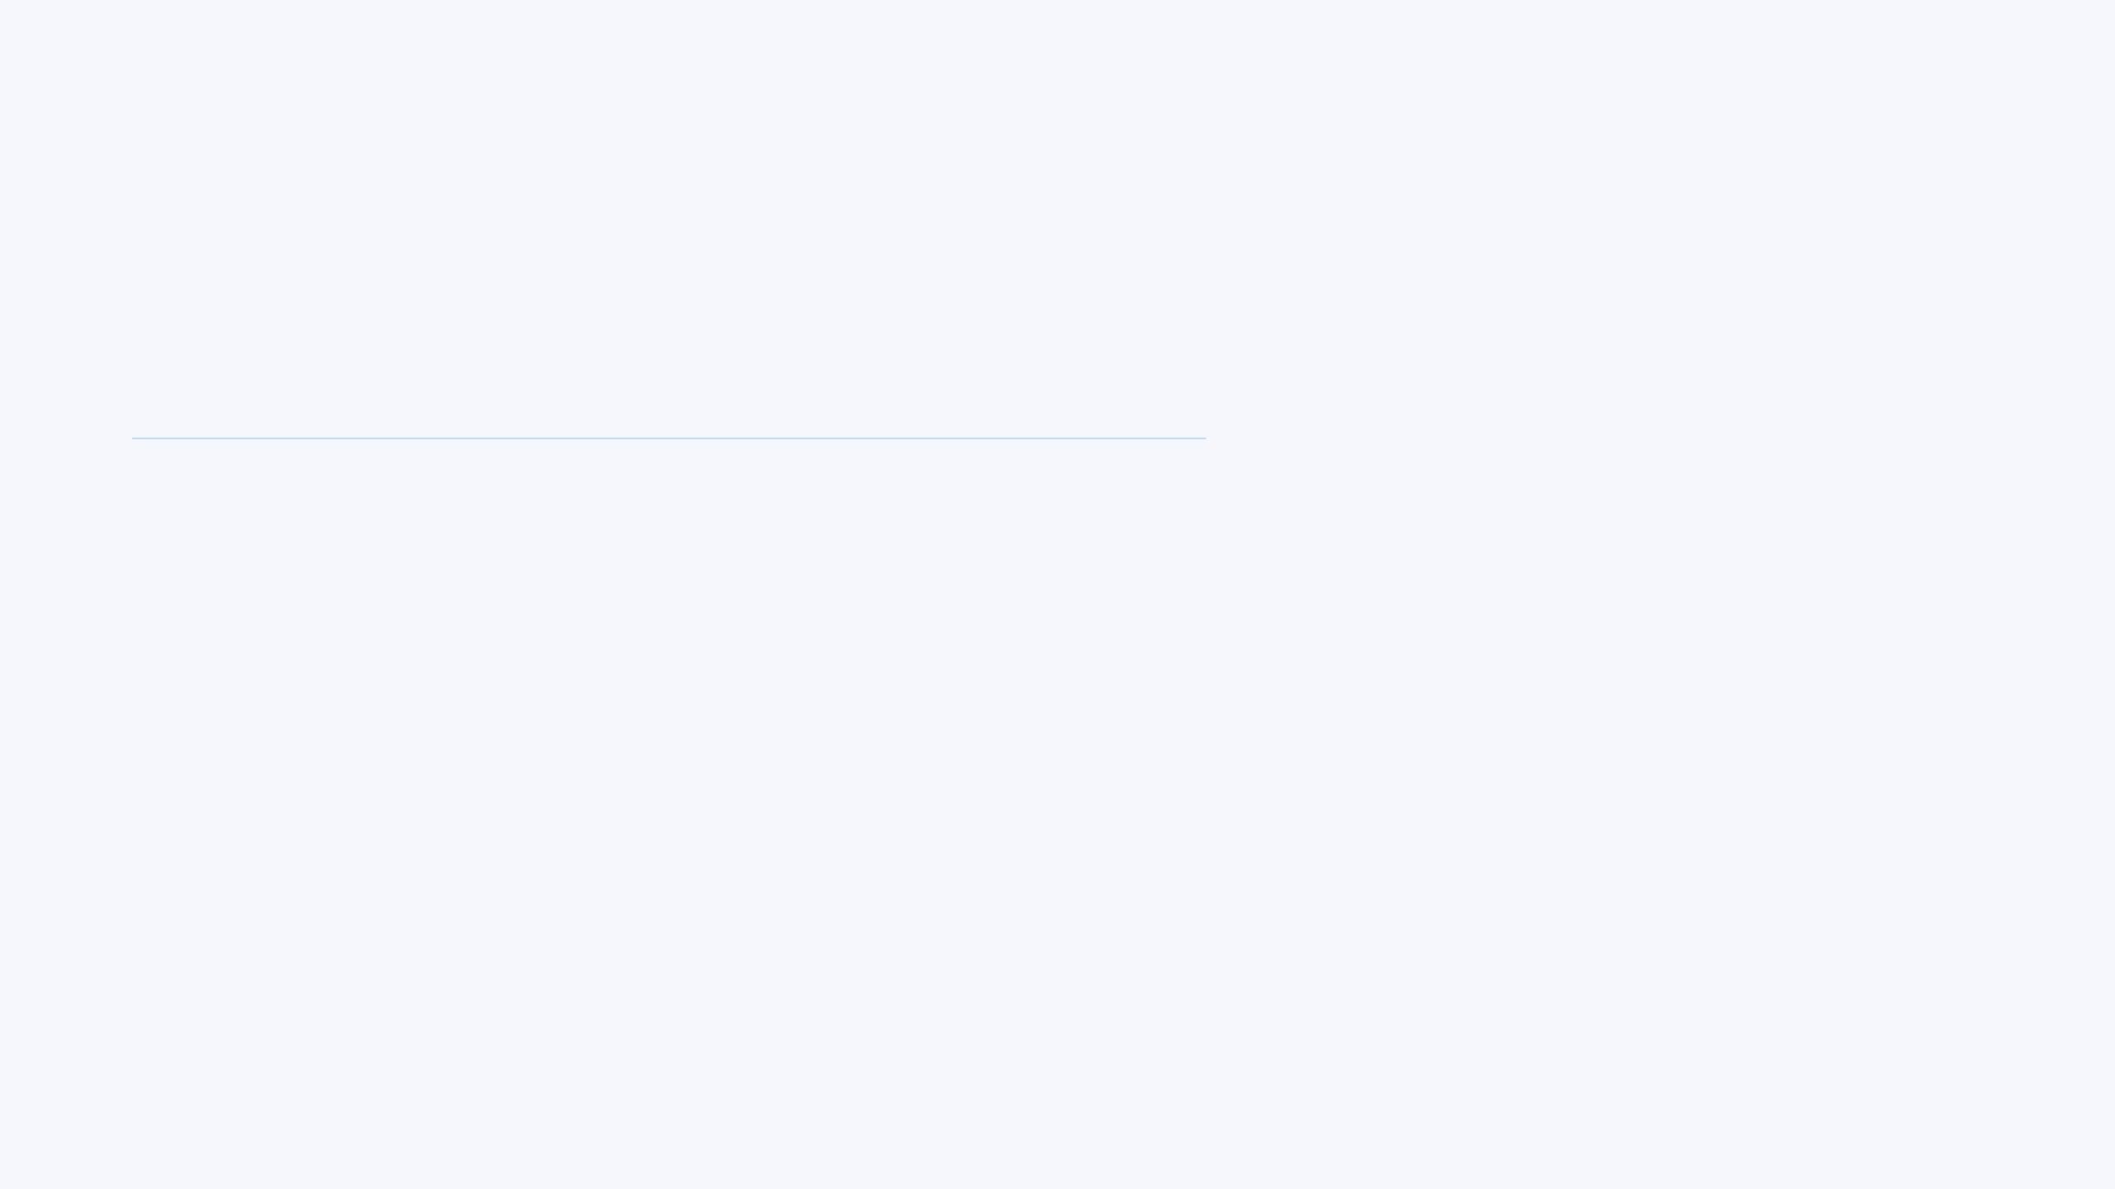




Concrete Observer: UI Synchronization
DashboardObserver.java
Selective Reaction
public class DashboardObserver implements HospitalObserver { // Called automatically by Subject.notifyObservers()
@Override
public void update(HospitalEvent event) { switch (event) { case PATIENT_ADDED, PATIENT_DELETED, EMPLOYEE_ADDED, EMPLOYEE_DELETED, DATA_LOADED -> refreshDashboard(); } } private void refreshDashboard() { lblPatients.setText(subject.getPatientCount()); lblStaff.setText(subject.getStaffCount()); } }
The observer uses a switch-case to filter events. It only refreshes the UI when data relevant to the dashboard changes.
State Pull
Once notified, the observer "pulls" the latest state from the Subject (HospitalData) to update its labels.
Encapsulation
The UI logic is entirely contained within the observer, keeping the main UI class clean and focused on layout.

Slide 10



Dynamic Event Flow Analysis
1
Trigger
A user interacts with the UI (e.g., clicks "Add Patient") and submits new data.
2
Action
HospitalData processes the request, updates its internal state, and calls notifyObservers().
3
Broadcast
The Subject iterates through its list of registered Observers and calls their update() method.
4
Reaction & Update
Each Observer (Dashboard, Table, Log) receives the event and refreshes its specific UI component.

Slide 11



Architectural Benefits & Principles
PRINCIPLE 1
PRINCIPLE 2
ADVANTAGE
Single Responsibility (SRP)
Open/Closed (OCP)
Scalability
The system is open for extension but closed for modification. We can add new UI views (Observers) without changing the core Subject code.
As the hospital grows, adding new modules like Pharmacy or Billing becomes seamless by simply registering them as new Observers.
The HospitalData class is only responsible for managing data and business logic. It doesn't need to know how the data is displayed or rendered in the UI.

Slide 12



Conclusion & Future Scalability
The Observer Pattern transforms a static data system into a dynamic, event-driven ecosystem.
Decoupling is the foundation of professional software architecture.
Mobile Integration
Cloud Sync
AI Diagnostics
Easily add mobile notification observers to alert doctors of critical patient updates instantly.
Implement a CloudObserver to synchronize local hospital data with a central database in real-time.
Plug in an AI analysis observer that listens for new patient data and provides automated insights.
Hospital Management System | Pattern Programming 2026

